Slide 2
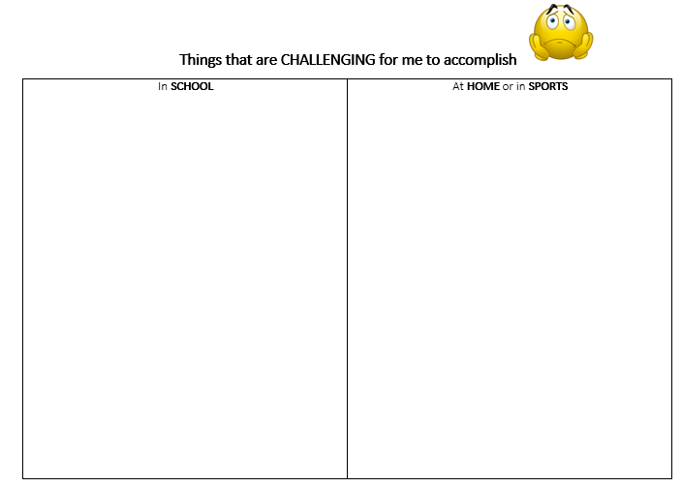

Slide 3
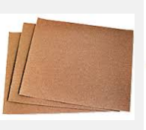
How does this feel?
Notes:
Students feel sandpaper and I jot down describing words on the board/chart

Slide 4
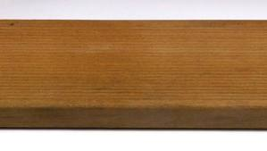
Notes:
I tell them we are going outside to do something fun – they bring a pencil. This is where they will sit around the wood
They will write the word GRIT on the wood
I time them for 3 minutes and they try to sand the word out. (they get hot, tired, sweaty, uncomfortable…many want to give up)
After 3 min, we stand in a circle and debrief

Slide 5
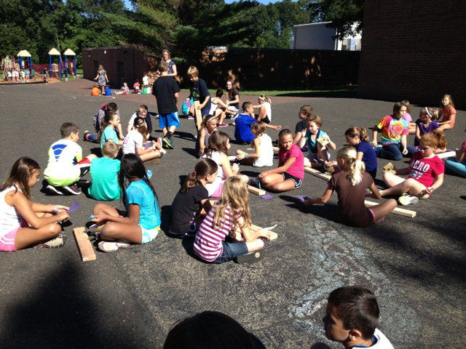

Slide 6
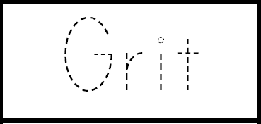
GRIT
Notes:
We come inside and write the word GRIT on an index card in capital letters. Anytime they see Leo showing GRIT, they hold up the card

Slide 7
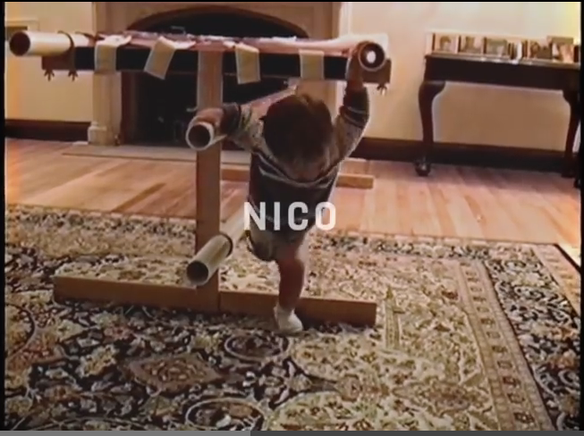
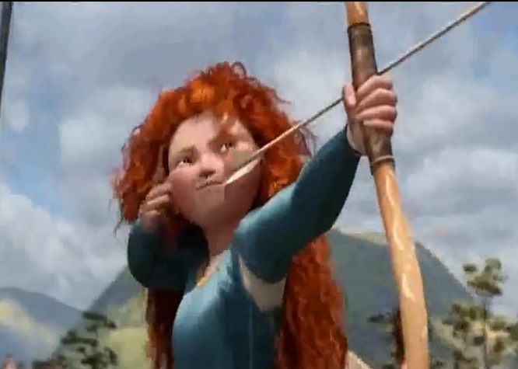
Nico’s Story
Brave

Slide 11
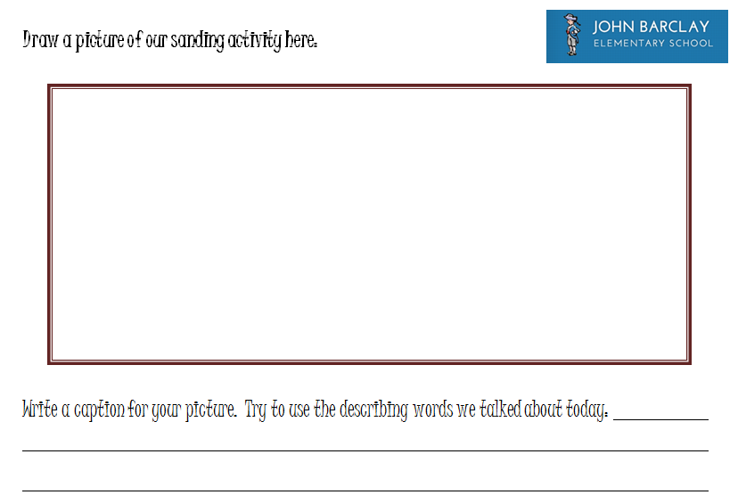
1
2
Notes:
Written Reflection

